Slide 1
써 왔던, 쓸 도구들

Slide 2
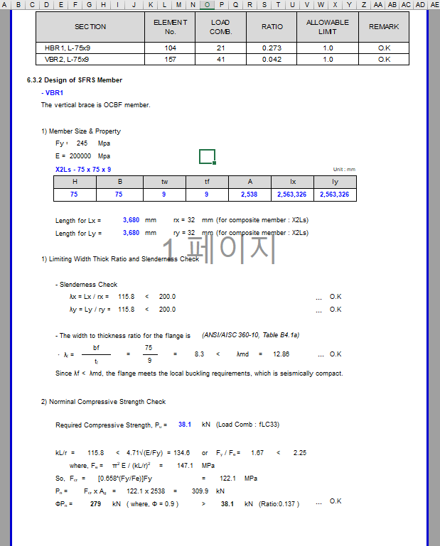
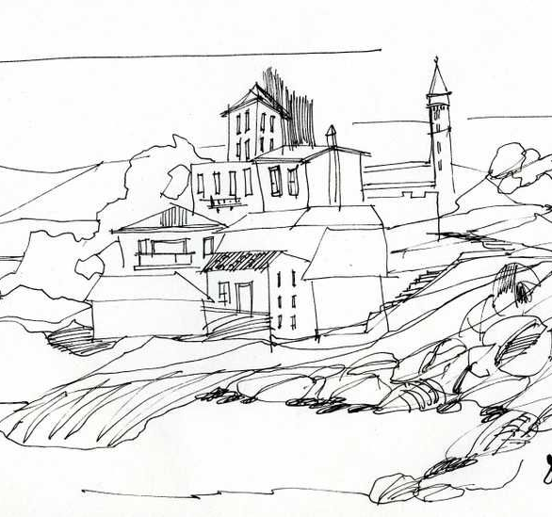
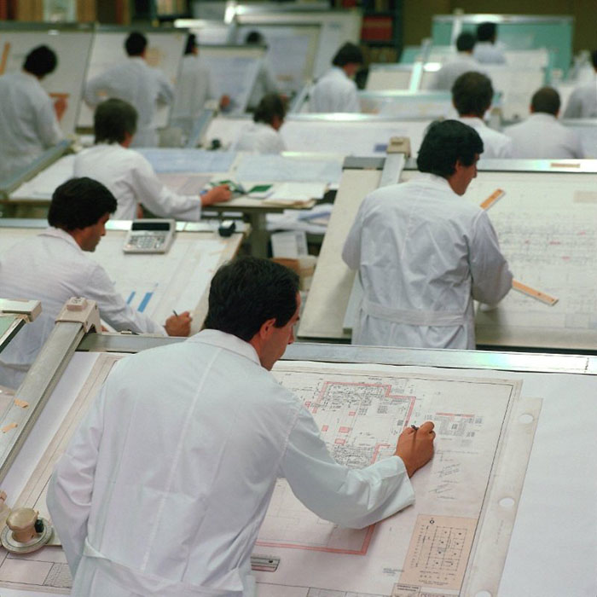
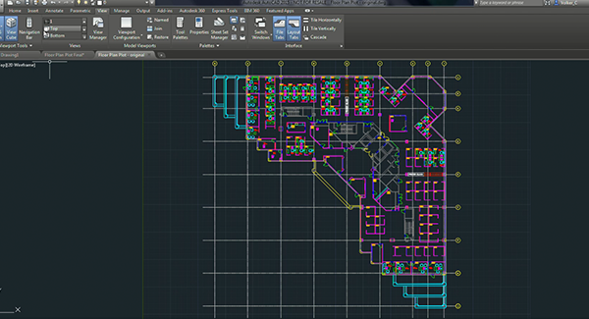
Personal Sketch
Default
Advanced

Slide 3
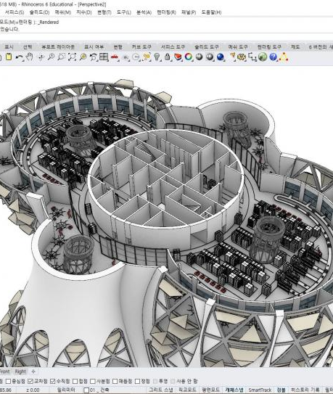
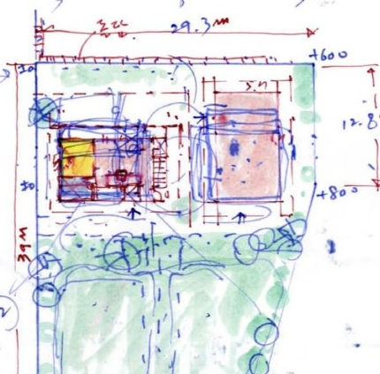
Personal Sketch
Default
Advanced

Slide 4
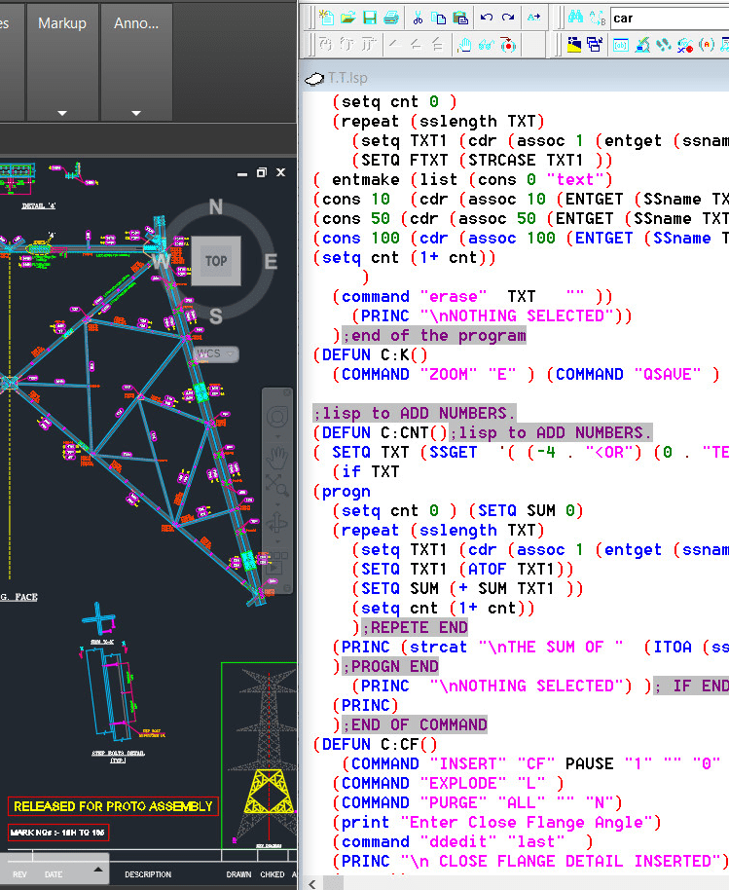
Personal Sketch
Default
Advanced

Slide 5
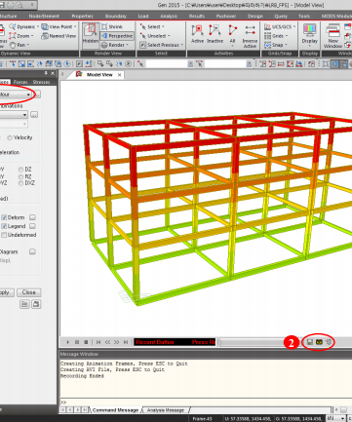
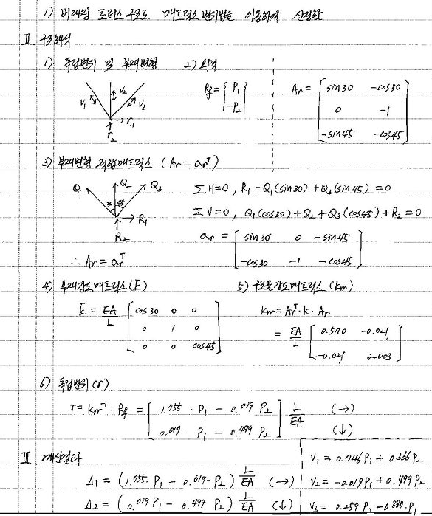
Personal Sketch
Default
Advanced

Slide 6
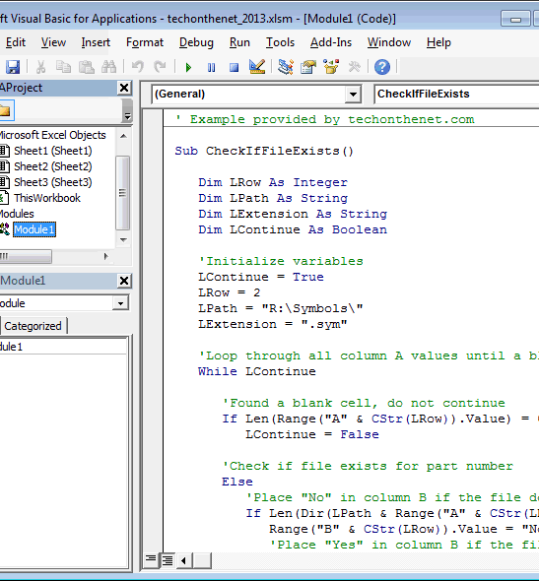
Personal Sketch
Default
Advanced

Slide 7
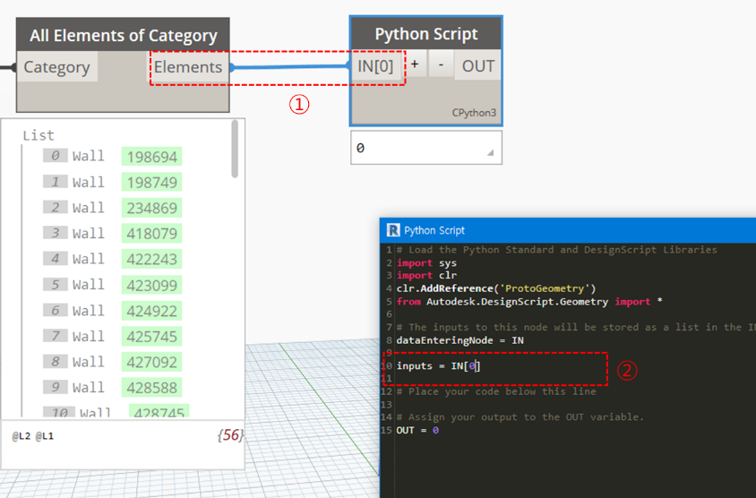
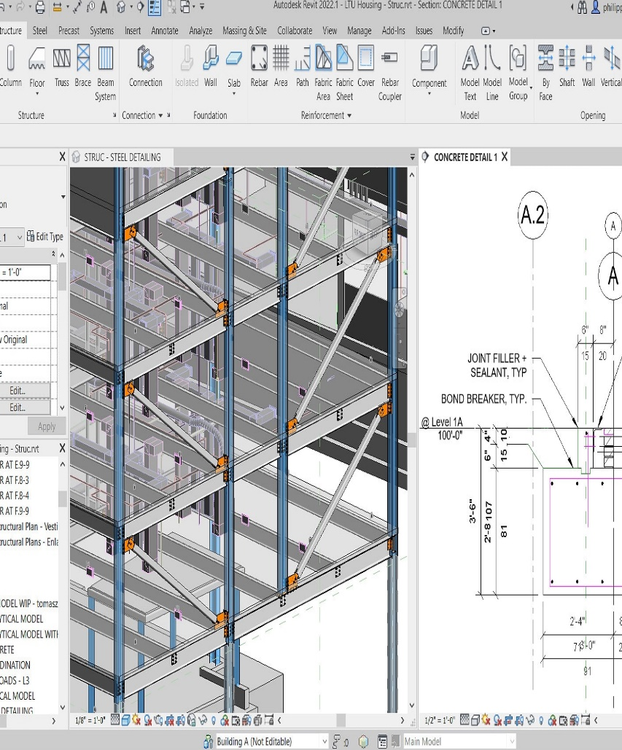
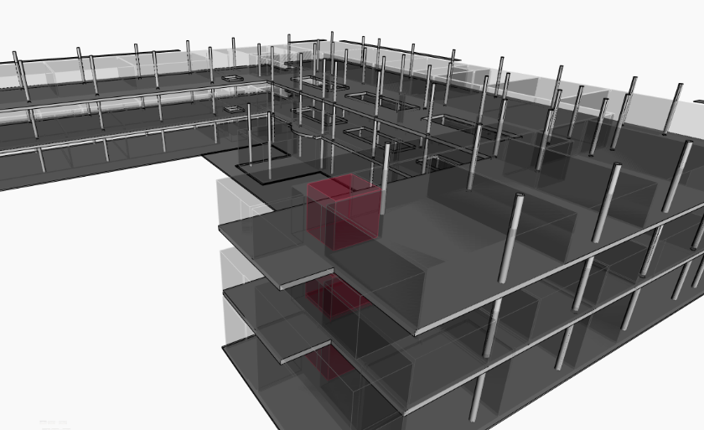
Personal Sketch
Default
Advanced

Slide 8
Personal Sketch
Default
Advanced
?

Slide 9
Personal Sketch
Default
Advanced

Slide 10
Personal Sketch
Default
Advanced

